Slide 1

Final Project BDAT 1001 Information Encoding Standards Instructor – Nital Shah
Kenta Shirakura
200206054

Slide 2
Summary of the project
Complete the code in the videos 1 - 10
Add my own secure API and serve a simple dataset of your own (Not completed)
Present the following:
Explain how JWT is used in API security
Demonstrate the API and acquire data from Post Man
Make a recommendation on which choice of Authentication method (OAuth, OpenId, or other) is best for API security
Answer Security Technologies Recommendations questions (Task 2)

Slide 3
JWT Token in API Security
In API Security, JWT Token is used to improve the security of the application by allowing the user to:
Go through a log in process to acquire the access token from authentication server
Then use that access token (JWT token) to get the data
JWT token is verified using the secret key in the signature part of JWT token

Slide 4
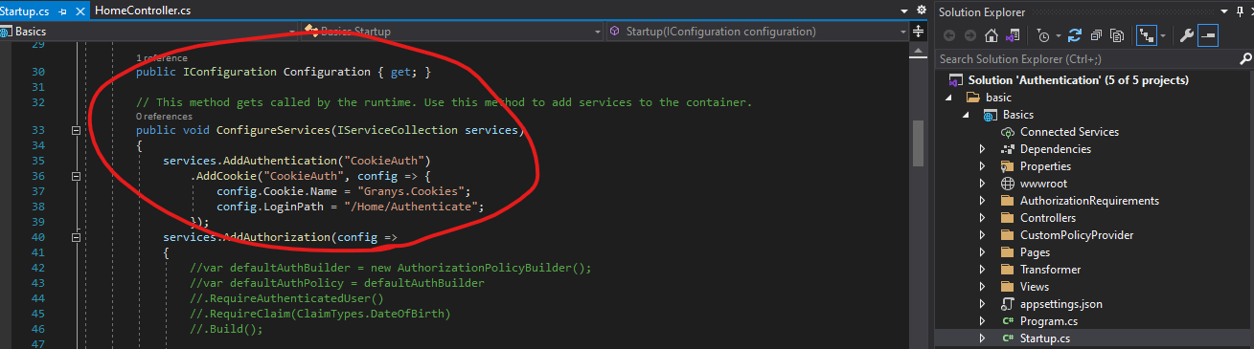
Cookie Auth

Slide 5
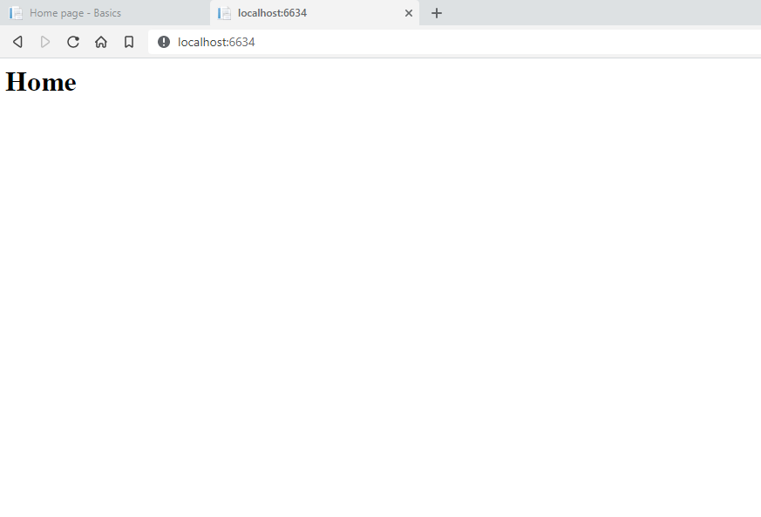
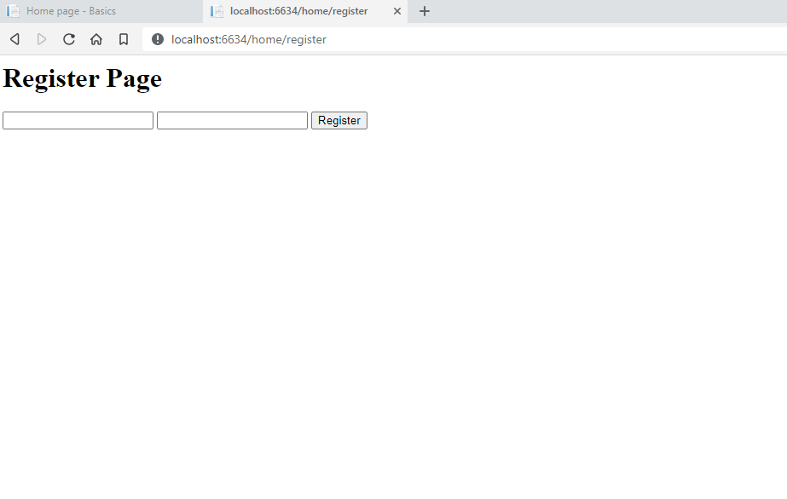
Demonstration of API

Slide 6
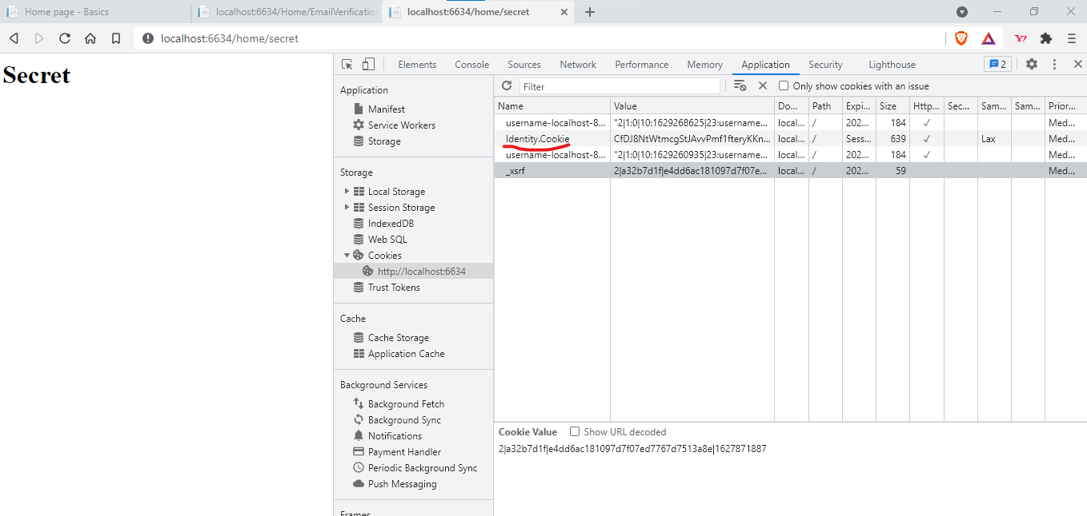
Demonstration of API

Slide 7
Recommended Authentication Method
OAuth and JWT Token
OAuth is great for personal user identification as well as to grant permissions to users properly.
Using OAuth method, users will log into a system which will request authentication, in the form of token.
We can use JWT Token as OAuth Bearer Tokens to encode all relevant parts of an access token into the access token itself allowing it a stateless authentication.

Slide 8
Task 2 questions
How can we transfer personal data securely within their network?
What Privacy Policies should we be aware of before we get started? Provide a checklist to follow.
What security policy is best for transferring personal information?
Can we encode and encrypt images?
Our database cannot be moved from the site and we need to be able to access it externally using a secure API? Explain the architecture of a secure API.
Can you recommend a secure framework for coding an API?
What data interchange format should we use while transferring data between locations?
How should we store our data in our many locations?
What are the ethical concerns related to the transmission of personal data?

Slide 9
Q. How can we transfer personal data securely within their network?
- There are multiple ways to securely transfer personal data within the network. File Transfer Protocol Secure (FTPS) is one of them. This method encrypts data files and the authentication information
Q. What Privacy Policies should we be aware of before we get started? Provide a checklist to follow.
- The privacy policy should answer questions as such:
What personal information is collected?
How and why is the information collected?
Who will have access to the information, and how is the information used?

Slide 10
Q. What security policy is best for transferring personal information?
- FTP is one method to transfer information however it may not be secure. The SSH (Secure Shell) suite of programs and protocols can provide a highly configurable way to transfer data safely and even encrypt data streams from other programs that are otherwise not secure.
Q. Can we encode and encrypt images?
- Yes you can encode them into Base64 format.
Q. Our database cannot be moved from the site and we need to be able to access it externally using a secure API? Explain the architecture of a secure API.
- Secure API may ask the user to login, and to receive the access token. So unless the user is authenticated, they may not access any data from the database using API.

Slide 11
Q. Can you recommend a secure framework for coding an API?
- ASP.NET Core is one of them which was used in this project. Using a combination of OAuth and JWT token, secure API can be built.
Q. What data interchange format should we use while transferring data between locations?
- JSON is a good format to use as it is light weight, and it is database friendly language.
Q. How should we store our data in our many locations?
- Cloud data storage may be a solution for storing the data in many locations. It will be accessible by all users if shared, and files and folder names can be name correctly and organized to allow users to find the data quickly.

Slide 12
Q. What are the ethical concerns related to the transmission of personal data?
- It is good to review questions as follows:
What personal information is collected?
How and why is the information collected?
The most important questions in the identifying ethical concern is who will have access to the information, and how is the information used. As well as the consent from the personal data owner that the data is sharable.

Slide 13
Thank you!

Slide 14
http://youtu.be/G9530hgkcO0?hd=1
Link to the video

